Slide 1
So the FDA is Coming to Visit Your Site - How do you Prepare?
Dial in: (415) 655-0060
Access Code: 687-140-269
Slides in “Handout” Tab
ORPP&E Webinar
September 26, 2019
Julia E. Vertrees, PharmD, BCPP – Director SMART

Slide 2
Presentation Purpose & Objectives
Dial in: (415) 655-0060
Access Code: 687-140-269
Slides in “Handout” Tab
To ensure that all trials conducted within VA are compliant with Human Subject Protections and VHA policies, and FDA guidelines and Good Clinical Practice as appropriate.
To enhance knowledge regarding:
  Proper preparation and organization of a clinical research trial prior to commencement of the trial.
  Preparation and conduct and close out of an FDA inspection.
  Comprehensive understanding of the documentation review process that is a focus for the FDA during an inspection.

Slide 3
The 50,000 Foot View of FDA Compliance Inspections
Dial in: (415) 655-0060
Access Code: 687-140-269
Slides in “Handout” Tab

Slide 4
FDA’s Office of Regulatory Affairs (ORA)
Office of Regulatory Affairs is the lead office for all agency field activities.
Inspects regulated products and manufacturers,
Conducts sample analyses of regulated products, and
Reviews imported products offered for entry into the United States.
Also, works with its state, local, tribal, territorial and foreign counterparts.

Slide 5
ORA Vision, Mission, and Values
Dial in: (415) 655-0060
Access Code: 687-140-269
Slides in “Handout” Tab
Vision
  All food is safe, all medical products are safe and effective, and the public health is advanced and protected.
Mission
  ORA protects consumers and enhances public health by maximizing compliance of FDA regulated products and minimizing risk associated with those products.
ORA Core Values
  Accountability - We take personal responsibility for meeting individual, team, and organizational commitments.
  Commitment to Public Health - We demonstrate our commitment to safeguarding the public health in our actions.
  Communication - We provide information that is accurate and clear, and in our interactions with others, we actively listen to understand other points of view.
  Diversity & Inclusion - We embrace each individual’s uniqueness and seek out their ideas and perspectives.
  Integrity and Respect - We adhere to the highest ethical standards by consistently being honest and trustworthy in our actions.
  Quality - We set high standards of excellence for our work and take the necessary actions to continuously improve.

Slide 6

Under the Umbrella of ORA
Dial in: (415) 655-0060
Access Code: 687-140-269
Slides in “Handout” Tab
Recalls & Alerts
  Recalls, Market Withdrawals, & Safety Alerts
  Import Alerts
  Enforcement Reports
Programs
  Import Program
  Bioresearch Monitoring Information
  Program Alignment
Topics
  Federal, State, Local, Tribal, and Territorial Officials
  Health Fraud Scams
  Criminal Investigations
  Inspections & Compliance
  Field Sciences and Laboratories
  ORA FOIA Electronic Reading Room
Compliance Manuals/Guides
  Compliance Policy Guides (CPG)
  Compliance Program Guidance Manual(CP)
  Regulatory Procedures Manual (RPM)
Inspection Manuals/Guides
  Investigations Operations Manual (IOM)
  Inspection Guides
  Inspection Technical Guides
This Photo by Unknown Author is licensed under CC BY-SA-NC

Slide 7
Office of Good Clinical Practice (OGCP)
Clinical Trials and Human Subject Protection
FDA’s Commitment
OGCP serves as:
Adherence to the principles of good clinical practice (GCP), including human subject protection (HSP), is universally recognized as a critical requirement to the ethical conduct of research involving human subjects.
The Food and Drug Administration (FDA) regulations for the conduct of clinical trials, which have been in effect since the 1970s, address both GCP and HSP.
FDA’s focal point for GCP and HSP issues related to FDA-regulated clinical trials:
Sets priorities for the development of GCP and HSP policy,
Works to ensure consistency in GCP and HSP policy across the agency,
Participates in international GCP and HSP harmonization activities, and
Serves as liaison to other Federal agencies and external stakeholders

Slide 8
FDA Compliance Programs
FDA’s Compliance Programs provide instructions to FDA personnel for conducting activities to evaluate industry compliance with the Federal Food, Drug, and Cosmetic Act and other laws administered by FDA.
  Biologics (CBER)
  Bioresearch Monitoring (BIMO)
  Devices/Radiological Health (CDRH)
  Drugs (CDER)
  Food and Cosmetics (CFSAN))
  Veterinary Medicine (CVM)

Slide 9
The 30,000 Foot View:
Biomedical Monitoring Program (BIMO)

Slide 10
Biomedical Monitoring Program (BIMO)
Office of Good Clinical Practice
The purpose of each BIMO program is to ensure the protection of research subjects, and the integrity of data submitted to the agency in support of a marketing application; and assess compliance with FDA's regulations governing the conduct of clinical trials.
Compliance Program Guidance Manuals (CPGM) form the basis of FDA’s BIMO programs are used to direct field personnel on the conduct of inspectional and investigational activities.
OGCP BIMO Program types:
  CPGM for Clinical Investigators
  CPGM for Sponsors, Contract Research Organizations, and Monitors
  CPGM for Good Laboratory Practice (Non-Clinical Laboratories)
  CPGM for In-Vivo Bioequivalence Compliance Program 7348.001
  CPGM for Institutional Review Boards

Slide 11
FY2018* BIMO¹ Inspections Classified
*Data includes domestic & international inspections
Center | CI | IRB | S/M/CRO | S/I | GLP | BEQ | PADE | REMS | Total
CBER | 75 | 3 | 13 | 7 | 0 | 0 | 0 | 0 | 98
CDER | 591 | 105² | 85 | 13 | 35 | 241 | 72 | 11 | 1153
CDRH | 25 | 5 | 53 | 2 | 12 | 0 | 0 | 0 | 347
CVM | 13 | 0 | 2 | 0 | 9 | 0 | 0 | 0 | 24
Total | 904 | 163 | 153 | 22 | 56 | 241 | 72 | 11 | 1622
Source: BIMO Inspection Metrics
¹ The FDA’s Bioresearch Monitoring (BIMO Program) consists of all six product centers: CBER,CDER, CDRH, CFSAN, CTP, and CVM. In FY18, CFSAN and CTP did not classify any inspections based on Center final classification date.
² The number of Institutional Review Board (IRB) inspections includes 4 Radioactive Drug Research Committee (RDRC) inspections.
Acronyms: CBER=Center for Biologics Evaluation and Research; CDER= Center for Drug Evaluation and Research; CDRH= Center for Devices and Radiological Health; CVM= Center for Veterinary Medicine; CI=Clinical Investigator; IRB=Institutional Review Board; S/M/CRO=Sponsor/Monitor/Contract Research Organization; S/I=Sponsor Investigator; GLP=Good Laboratory Practice; BEQ=bioequivalence; PADE= Postmarketing Adverse Drug Experience; REMS=Risk Evaluation Mitigation Strategies

Slide 12
Clinical Investigator Defined
In contrast to an “Investigator Sponsor”
A clinical investigator is the individual who actually conducts the clinical investigation [21 CFR 312.3, 21 CFR 812.3(i)].
The investigator is responsible for overall conduct of the study at the study site, including:
  directing the administration or dispensing of the test article to the subject, and
  ensuring that data are collected and maintained in accordance with the protocol and regulatory requirements.
When the investigation is conducted by a team of individuals, the clinical investigator is the leader of the team.
A sponsor-investigator is an individual who initiates and also conducts the clinical investigation. A sponsor-investigator must comply with regulatory requirements applicable to both sponsors and clinical investigators.

Slide 13
The Nitty Gritty:
Notification of an Inspection

Slide 14
How You Will Receive Notification of Inspection?
Routine Inspections
  Generally, the FDA investigator will notify the principal investigator by phone and establish a date for the inspection.
  The FDA inspector will usually request that the inspection take place within 10 days.
For Cause Inspections will not provide notice of inspection in advance.
Remember to document all phone calls and correspondences with the FDA.

Slide 15
BIMO Inspections: When and Why
Primarily to inspect entities involved in studies submitted as part of an application for approval of new product.
  Typically, inspections are conducted well after a nonclinical or clinical study has been completed.
  Inspections may also be conducted of on-going research.
  May also be to conduct investigations and for sample collections.
Source: INVESTIGATIONS OPERATIONS MANUAL 2019, Chapter 5, Section 5.10.2 – BIMO Assignments

Slide 16
Site Inspection Selection Factors
Why FDA comes to see YOU
The FDA typically inspects the top enrolling site and randomly picks 10% of the remaining sites for inspection
Criteria that ‘attract attention”:
  The frequent occurrence of “outlier” data
  High/low numbers of participants responding to the study treatment
  High numbers of dropouts
  High numbers of adverse event (AEs/SAEs)
  High numbers of Protocol Deviations
  The volume of work performed by the clinical investigator

Slide 17
Additional Inspection Selection Triggers
High enrollment (especially in a short time)
Few adverse events or high adverse events
Results different from other sites
Patient complaints
Investigators with many studies
Investigator on study outside of specialty
Sponsor reports poor quality data or other difficulties

Slide 18
Who do YOU notify?
Once you know the FDA is coming…
Sponsor
  Lead Monitor / CRA (If CSP also the SMART Director)
  For CSP Trials
    CSP-CC: Director who will notify the CSP Director; ACDQA; QA RN; PM; Bio/PD
    CSP-PCC: Director; CRP, PM; ACDQA
Locally
  ACOS for Research, RCO, NODES (if applicable)
  All site study team members on delegation of authority list including research pharmacist
IRB of record
Chair’s Office for multi-center trials
VA Central Office: ORO, ORPP&E, Program Office

Slide 19
Initial Steps at Your Site
Once you know the FDA is coming…
Ensure all team members are aware of the
  Scope of the Inspection
  Reason for the Inspection
  Date(s) for inspection and audit teams arrival time
Identify a private conference room or office for the FDA field investigator to use
  Internet access
  Photocopier/ fax access
  Proximity to rest room
Identify nearby room for main research personnel as support

Slide 20
The Nitty Gritty:
Preparation for Inspections

Slide 21
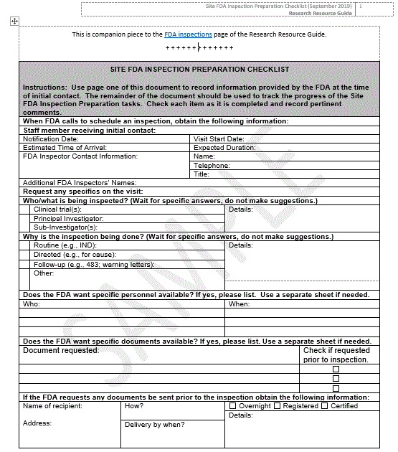


The Importance of Continual Readiness
Checklist for success / areas of preparation
Administrative
Regulatory
Clinical
Laboratory
Pharmacy

Slide 22
Always Be in a State of Continual Readiness
(a few) Best Practices for Continual Readiness
Always …
  Store all binders with identifiable information in a locked and secure area.
  Store study drug / device in a locked secure area. Only those on the study team may have access to this area.
    If in the pharmacy, must be stored away from regular inventory.
  Password protect all enrollment spreadsheets and other PHI with study team members only having access, especially if kept in a shared drive.
  Do not email any PHI (enrollment logs, etc.) unless encrypted.
    Know and adhere to VA Privacy and Information Security Awareness and Rules of Behavior (ROB)
  Ensure that all SOPs and DSMP are up to date and available as a reference during the inspection.
  No white out ever – cross through with one line – date and initial.

Slide 23
Best Practices for Continual Readiness
a few more…
Informed Consent process should be documented in the physician progress record and/or a memo to file with the consent.
  Pay attention to inclusion and exclusion criteria
Stay up to date: filing, CRF submissions, queries, etc.
Why – because the FDA can request records in advance of an inspection
  Form FDA 482c Notice of Inspection - Request for Records

Slide 24
Organize Your Team for Success
Preparation for Inspections
Front Room (FR)
  Notetaker / Scribe;
  Audit Facilitator;
  SMEs;
Back Room (BR)
  Back room lead;
  Back room coordinator;
  Study manager & Functional leads (SMEs);
  Quality reviewers;
  Runners

Slide 25
Preparation for Inspections - Roles
Suggestions for organizing your team
FR Role | Purpose
Notetaker (Scribe) | Responsible for documenting all communications and auditor request. Capturing live minutes in the scribe notes for all important parties to see If possible, communicate live with the back room
Audit Facilitator | Audit Leads: Quality and/or clinical Ensure that auditor’s request are fulfilled and in time and fashion that auditor requests. Control the sequence and timing of request (including SMEs/people) to be presented to auditor
SMEs | Present an over of how a function is performed; field questions related to records requested by the auditors,. This situation may have the SME remaining through the review of their area. To clarify records that eh SME owns or role controls
BR Role | Purpose
Back Room Lead | Manage the incoming formal document request & the flow of documents Communicates with the FR Scribe and Facilitators via SKYPE or chat
Back Room Coordinator | Assists the BR Lead with requests, the progress of the requests, the backroom flow, etc.
Study Manager & Functional Leads (SMEs) | Assist with document request, as needed. Strategizes with SMEs, Clinical Quality and others, as needed Contact remote SMEs, as needed
Clinical team personnel | Retrieves documents, ensures that documents appropriately identify the study and include dates/version, if needed
Quality Reviewers | Review document to ensure that are ready for delivery to the FR
Runners | Take document and SMEs to the front room.

Slide 26
The Nitty Gritty:
Day of Inspection

Slide 27
The Field Investigator arrives …
During Inspection
Meeting FDA Field Investigator
  Arrange to meet at main entrance
  FDA investigator presents Form 482 – Notice of Inspection*
  FDA field investigator to show identification
  FDA Field investigator to sign in audit/guest log
* FDA inspector will present an additional Form 482 to the PI if not available for the opening meeting

Slide 28
First Requests
During Inspection
Field investigator will tell PI / research personnel what he / she wants to review
  Will specify order of review
  May wish all files to be provided at once
Requests list of all studies performed by investigator
  Protocol number
  Title
  Regulatory Sponsor Name
  Study Dates

Slide 29
What the Inspector Will Do in General
During Inspection
Review of Records
  Compare source documents to case report forms
  Compare files on site to sponsor-provided data
  Reviews product management if investigation product is still on site
May request additional documents, information, source, etc.
May request to meet with certain study personnel or ask study team clarifying questions

Slide 30
A Few Expectations During the Visit
During Inspection
The Field Investigator may request copies of records that demonstrate discrepancies between source data, CRFs, or Data from sponsor
  Research team member should make 2 copies
  1st copy for FDA field investigator
  2nd for internal audit file (your record of the visit)
YOU should request a daily debriefing meeting with FDA Field Investigator
  TAKE NOTES!

Slide 31
FAQs from the FDA Inspector to YOU
During Inspection
Do you have experience as a Principal Investigator?
Can you summarize the protocol?
Who were the research team members involved in seeing subjects and collecting data?
  How were they trained?
  How is their competence documented?
Who completed the case report forms?
How is / was the test article controlled?
Who has access to master study file (paper / electronic)? i.e., all your essential documents, etc.
  How is that access secured?

Slide 32
Regulatory Essential Documents
During Inspection – Examples of what is reviewed
1572/Investigator Agreement
Appropriate delegation of study tasks by the PI
IRB submissions and correspondence history
Protocol versions approved by IRB
Sponsor correspondence and reporting history
Consent form versions approved by IRB
Information about location where subjects were seen
Subject recruitment materials and process
Enrollments log (will request paper copy)
Monitoring activities and reports

Slide 33
Subject Case Histories
During Inspection – Examples of what is reviewed
Source records (CPRS, Lab/Path/Radiology reports, subject diaries, etc.)
Case Report Forms
Eligibility Criteria data
Protocol compliance and documentation of deviations
Signed, original informed consent forms
Events recording and documentation
Key Dates
  IRB approvals
  1572/ Investigator Agreement signature date
  First subject screened
  First subject consent
  First administration of test article
  Last follow-up for study subjects

Slide 34
Other Study Reports
During Inspection – Examples of what is reviewed
Confirmation that the investigator disclosed information about his/her financial interests to the sponsor
Compliance with 21 CFR 11 electronic records and signatures for applicable systems
Applicable procedures and site SOPs
Data collection practices
Security of data
Investigational product control
  Shipping, storage, dispensing, destruction

Slide 35
Communicating with FDA Field Investigator
During Investigation
Do NOT answer any question when you do not know the answer
  Inform inspector you will get the information requested and get back to him / her with the answer or bring the appropriate SME
Do NOT disparage the sponsor / funder / institution
  Any concerns you have with one of these entities should be communicated to the appropriate stakeholder outside inspection environment
The PI MUST take responsibility for all aspects of study management and file status in concordance with 1572 / Investigator Agreement
  Denying responsibility to the FDA field investigator can be detrimental

Slide 36
General Tips
During the Inspection
Be polite and respectful
Provide anything that the field investigator requests.
  Refusals are not tolerated.
Utilize your internal support teams (IRB, RCO, Sponsor).
Remember to use the team you set up to assist.
  Particularly the team member who can make copies as requested by the field investigator.
Remain available throughout the inspection
  Check in frequently and be clear on the frequency expected by the field investigator.

Slide 37
The Nitty Gritty:
Closing Meeting

Slide 38
Closing of the Inspection
The FDA Field investigator will request a meeting with the PI
  Recommend having representatives from your facility and any Sponsor representatives who came to support the inspection.
  May wish to invite an IRB representative if findings may be related to IRB submissions or review.
Field investigator will provide opportunity to PI or Medical Center representative to ask questions and / or provide initial verbal response.
  Take immediate corrective action of findings or propose a plan to do so, if at all possible.

Slide 39
Possible FDA Inspection Outcomes
No Written Observations (Yippee)
FDA Form 483 – Inspectional Observations
  Observations that appear to constitute violation of FD&C act
  Other observations may be discussed verbally
  PI signs copy of the 483
  Copy left with site, FDA field investigator takes original
Warning Letter (would usually only be issued after review of the Establishment Inspection Report (EIR) and any 483’s issued)
Classifications made after review: No Action Indicated (NAI); Voluntary Action Indicated (VAI); Official Action Indicated (OAI)

Slide 40
Disclaimer on FDA 483
This document lists observations made by the FDA representative(s) during the inspection of your facility.
They are inspectional observations; and do not represent a final agency determination regarding your compliance.
If you have an objection regarding an observation, or have implemented, or plan to implement corrective action in response to an observation,
  you may discuss the objection or action with the FDA representative(s) during the inspection, or
  submit this information to FDA at the <address above>.

Slide 41
FY18 Clinical Investigator Inspections Classified
Clinical Investigator Data
Source: BIMO Inspection Metrics

Slide 42
VA Facility ORA Classified Inspections*
10-1-2008_through_8-14-2019
Source: https://www.fda.gov/inspections-compliance-enforcement-and-criminal-investigations/inspection-references/inspection-classification-database
Center | Project Area | NAI | VAI | OAI
CDRH | Compliance: Devices |  | 2
CDRH | Postmarket Assurance: Devices | 2
CDRH | Project Evaluation: Devices | 7 (7)
CDER | Bioresearch Monitoring | 34 (28) | 10 (6)
CDER | Drug Quality Assurance |  | 4 | 1
CBER | Blood and Blood Products | 580 (1) | 111
CBER | Human Cellular, Tissue, and Gene Therapies | 13 (1)
Data was hand-extracted from the 227,854 unique records*
  Classification: No Action Indicated (NAI) / Voluntary Action Indicated (VAI) / or Official Action Indicated (OAI)
Numbers in ( ) are inspections specifically noted to be of a VA IRB.
Remaining inspections are presumed to be of the general focus noted in the relevant Project Area Compliance Program Manual
Caveat – the listing of individuals does not include the entity to which they are affiliated therefore this table does not include individual VA investigators

Slide 43
Common Clinical Investigator Deficiencies*
Reminder
2017
2018
Failure to follow the investigational plan/agreement or regulations, or both
Protocol deviations
Inadequate recordkeeping
Inadequate subject protection – informed consent issues, failure to report AEs
Inadequate accountability for the investigational product
Inadequate communication with the IRB
Investigational product represented as safe/effective.
Failure to conduct an investigation in accordance with the signed investigator statement or agreement / investigational plan / applicable regulations
Inadequate or inaccurate case histories
Investigator’s subject records inadequate
Inadequate drug / device disposition records
Failure to obtain informed consent in accordance with Part 50
* Clinical Investigator (CP 7348.811) deficiencies identified in FDA Form 483 issued at close of inspections;
Source: BIMO Inspection Metrics

Slide 44
Responding to Form 483 Observations
Always respond formally, in writing, to inspectional observations written on Form 483
Work with IRB, RCO and Section / Department and Sponsor to finalize response language
  Cite each finding and CAPA, including timeline, for action to be completed and documented
Consult with legal, as appropriate
Send response within 15 days of inspection

Slide 45
General Readiness is Best Defense
Continual Readiness is the watch-word!
Be inspection ready at all times
Respond to sponsor queries and monitoring reports in timely fashion
If your are a sponsor-investigator, ensure a monitoring strategy is being executed and documented
Keep up to date on subject and essential regulatory binder filings
Ensure clear documentation of PI oversight of all site responsibilities
Have your own SOPs for inspections with delegation of roles and responsibilities

Slide 46
The Wrap Up:
Tools and Assistance

Slide 47
Resources and Contacts
Research Resource Guide (RRG): a site with a plethora of useful information
  A New Tab specific to FDA Inspections
  Information with links to much of the material used to create this presentation
  Sample checklist for use by clinical investigators facing a visit from FDA
Office of Research Oversight (ORO)
  ORO Checklists and Audit Tools
Office of Research Protections, Policy, and Education (ORPP&E)
  Currently: Dr. Karen Jeans or Dr. Molly Klote

Slide 48
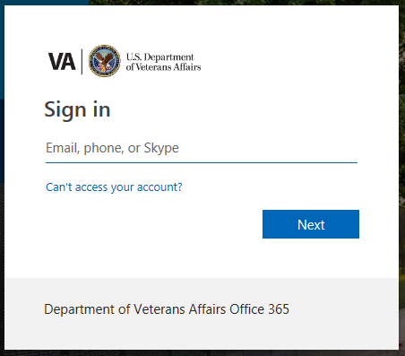
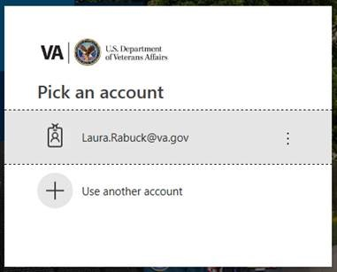
Research Resource Guide (the RRG)
Accessing the RRG
First Visit
Subsequent Visits
Full URL: https://dvagov.sharepoint.com/sites/VHAPugResearch/RRG/Pages/FDA-Inspections.aspx
Short URL: http://go.va.gov/l2o8

Slide 49
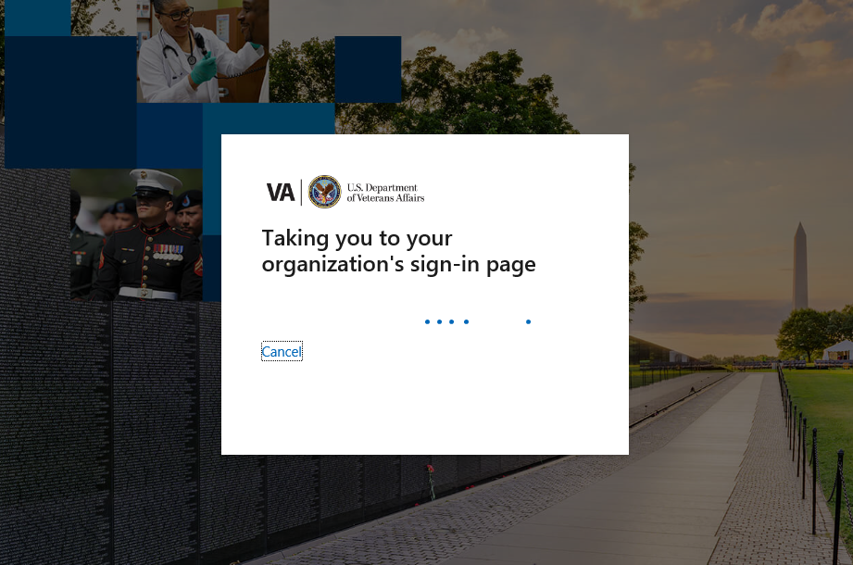
Waiting for the RRG to load

Slide 50
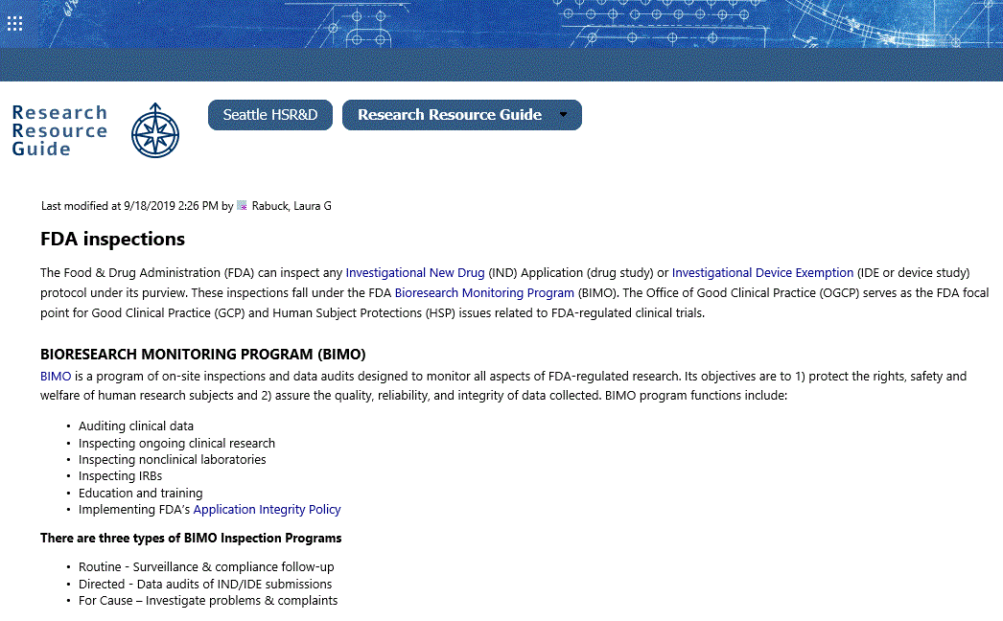
What the RRG Looks like
http://go.va.gov/l2o8

Slide 51
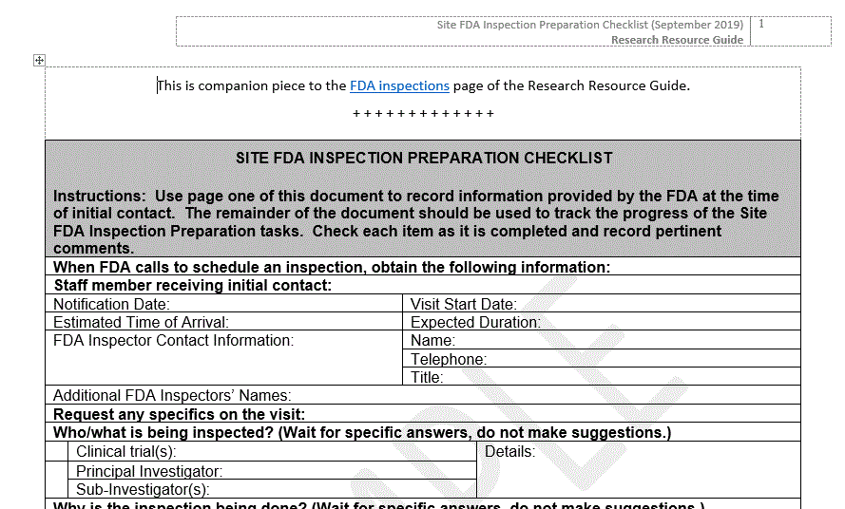
Sample Inspection Checklist for Investigators
http://go.va.gov/l2o8
Scroll to the bottom of the RRG FDA Inspections page to find the link to this document

Slide 52
Speaker Contact Information
Julia E. Vertrees, PharmD, BCPP
  Director, SMART
  VA Cooperative Studies Program
  Voice: 505.248.3203
  Email: Julia.vertrees@va.gov
Caveat: SMART is not the focal point for all FDA inspection in VA.
  Reach out to ORO and/or ORPP&E if you are notified of an inspection.
  SMART will be brought into an inspection as requested by ORO and/or ORPP&E.

Slide 53

Open Discussion
This Photo by Unknown Author is licensed under CC BY-NC-ND

